Slide 1
MTH 166 Lecture-32
Surface Area and Surface Integral

Slide 2
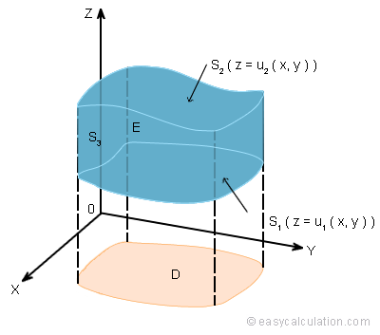

Area Element and Surface Area
1. If the projection of the surface $z=f(x,y)$is taken on $xy−$plane.
Area element, $dA=\sqrt{1+{f_{x}}^{2}+{f_{y}}^{2}}$
Surface Area, $A=\iint_{R}{dA}=\iint_{R}{\sqrt{1+{f_{x}}^{2}+{f_{y}}^{2}}dxdy}$

Slide 3
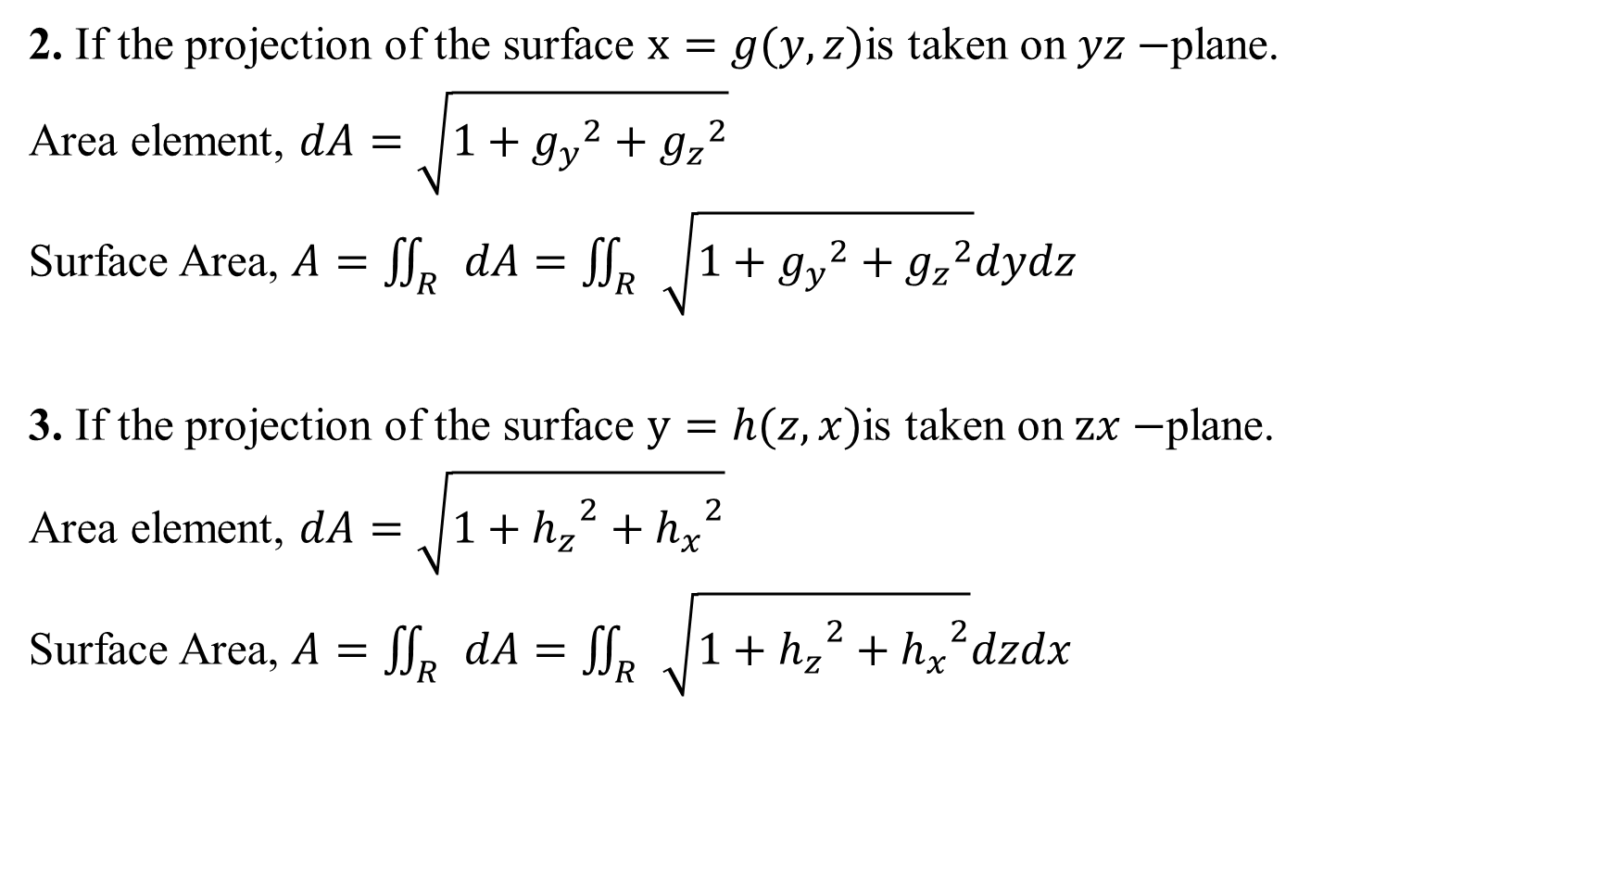
2. If the projection of the surface $x=g(y,z)$is taken on $yz−$plane.
Area element, $dA=\sqrt{1+{g_{y}}^{2}+{g_{z}}^{2}}$
Surface Area, $A=\iint_{R}{dA}=\iint_{R}{\sqrt{1+{g_{y}}^{2}+{g_{z}}^{2}}dydz}$
3. If the projection of the surface $y=h(z,x)$is taken on $zx−$plane.
Area element, $dA=\sqrt{1+{h_{z}}^{2}+{h_{x}}^{2}}$
Surface Area, $A=\iint_{R}{dA}=\iint_{R}{\sqrt{1+{h_{z}}^{2}+{h_{x}}^{2}}dzdx}$

Slide 4
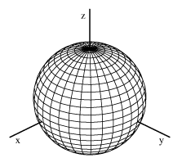

Important Questions from MCQ Point of View:
Problem 1. Find the surface area of $x^{2}+y^{2}+z^{2}=a^{2}$
Solution: Since it is sphere of radius $a$
So, Surface area of sphere, $S=4πr^{2}$
$⇒S=4π{\left(a\right)}^{2}$ Answer.

Slide 5
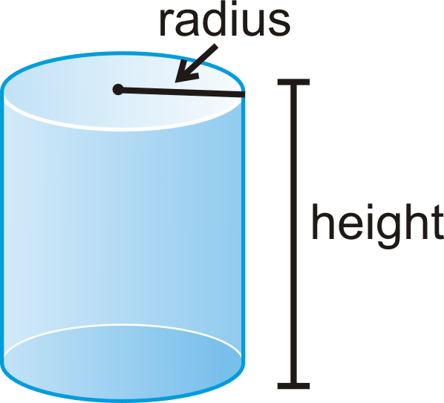

Problem 2. Find the surface area of $x^{2}+y^{2}=16, 0≤z≤2$
Solution: Since it is cylinder of radius $4$ and height 2.
So, Surface area of cylinder, $S=2πrh$
$⇒S=2π\left(4\right)\left(2\right)=16π$ Answer.

Slide 6
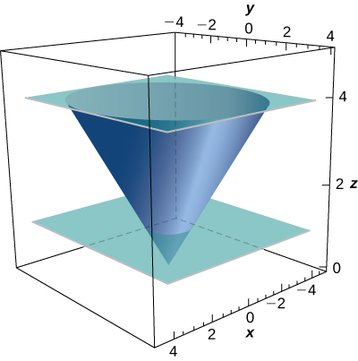
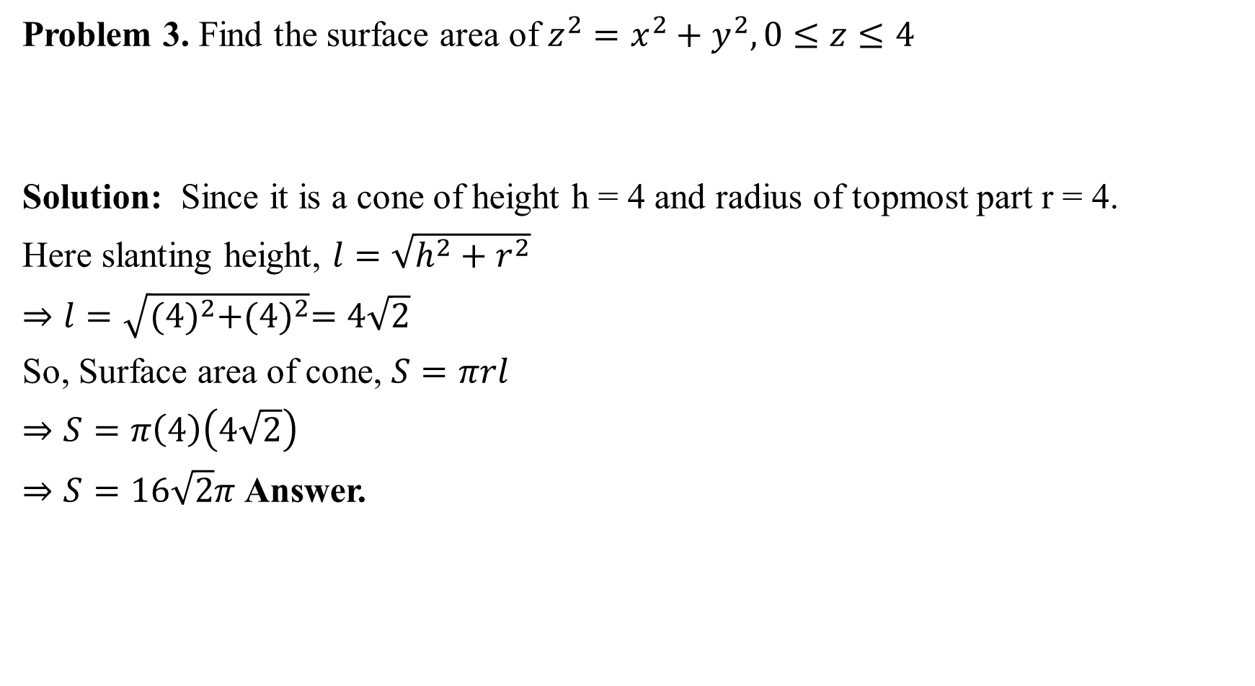
Problem 3. Find the surface area of $z^{2}=x^{2}+y^{2}, 0≤z≤4$
Solution: Since it is a cone of height h = 4 and radius of topmost part r = 4.
Here slanting height, $l=\sqrt{h^{2}+r^{2}}$
$⇒l=\sqrt{{(4)}^{2}+{(4)}^{2}}=4\sqrt{2}$
So, Surface area of cone, $S=πrl$
$⇒S=π\left(4\right)\left(4\sqrt{2}\right)$
$⇒S=16\sqrt{2}π$ Answer.

Slide 7
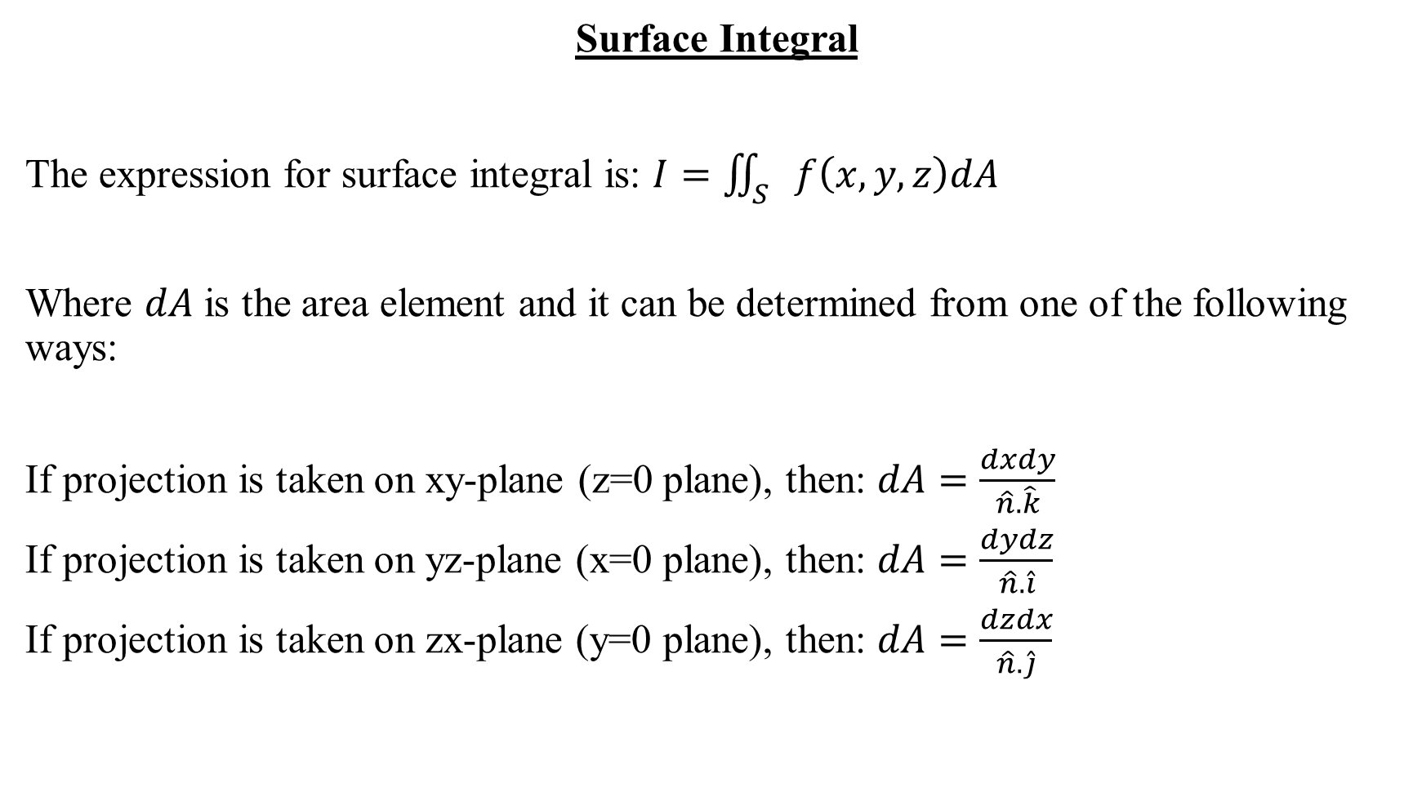
Surface Integral
The expression for surface integral is: $I=\iint_{S}{f\left(x,y,z\right)dA}$
Where $dA$ is the area element and it can be determined from one of the following ways:
If projection is taken on xy-plane (z=0 plane), then: $dA=\frac{dxdy}{\hat{n}.\hat{k}}$
If projection is taken on yz-plane (x=0 plane), then: $dA=\frac{dydz}{\hat{n}.\hat{i}}$
If projection is taken on zx-plane (y=0 plane), then: $dA=\frac{dzdx}{\hat{n}.\hat{j}}$

Slide 8
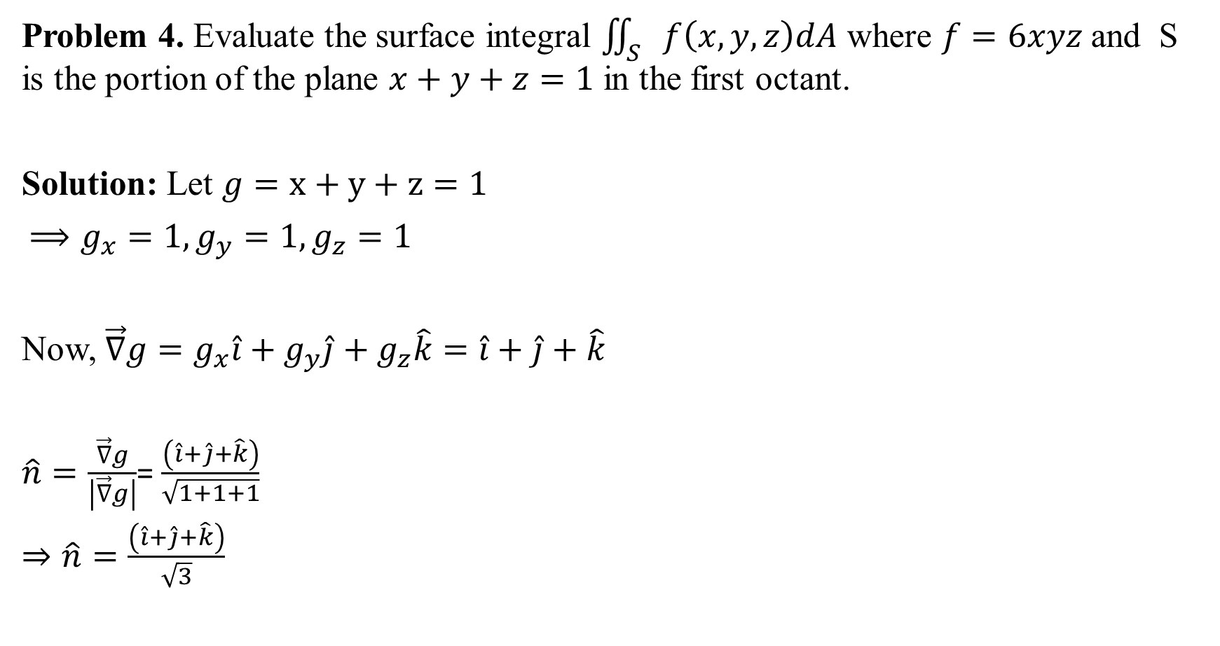
Problem 4. Evaluate the surface integral $\iint_{S}{f\left(x,y,z\right)dA}$ where $f=6xyz$ and S is the portion of the plane $x+y+z=1$ in the first octant.
Solution: Let $g=x+y+z=1$
$⟹g_{x}=1,g_{y}=1,g_{z}=1$
Now, $\vec{∇}g=g_{x}\hat{i}+g_{y}\hat{j}+g_{z}\hat{k}=\hat{i}+\hat{j}+\hat{k}$
$\hat{n}=\frac{\vec{∇}g}{\left|\vec{∇}g\right|}$= $\frac{\left(\hat{i}+\hat{j}+\hat{k}\right)}{\sqrt{1+1+1}}$
$⇒\hat{n}=\frac{\left(\hat{i}+\hat{j}+\hat{k}\right)}{\sqrt{3}}$

Slide 9
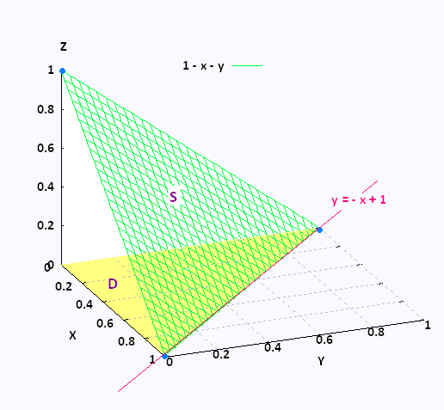

Let projection of Surface S be taken on xy-plane:
$z=1−x−y$
$dA=\frac{dxdy}{\hat{n}.\hat{k}}=\frac{dxdy}{\frac{\left(\hat{i}+\hat{j}+\hat{k}\right)}{\sqrt{3}}.\hat{k}}$
$⇒dA=\frac{dxdy}{\frac{1}{\sqrt{3}}}$
For limits: On xy-plane( z = 0)
So, $x+y+0=1⇒y=\left(1−x\right)$
$0≤y≤(1−x)$
On x-axis (y = 0, z = 0)
So, $x+0+0=1⇒x=1$
$0≤x≤1$

Slide 10

So, required surface integral is:$I=\iint_{S}{f\left(x,y,z\right)dA}$
$⇒I=\iint_{S}{(6xyz)}$ $\frac{dxdy}{\frac{1}{\sqrt{3}}}$
$=6\sqrt{3}\int_{x=0}^{1}{\int_{y=0}^{1−x}{xy\left(1−x−y\right)dxdy}}$
$=6\sqrt{3}\int_{x=0}^{1}{\int_{y=0}^{1−x}{(xy−x^{2}y−xy^{2})dydx}}$
On simplification, we get:
$I=\frac{\sqrt{3}}{20}$Answer.

Slide 11

This Photo by Unknown Author is licensed under CC BY-NC

